Slide 1

Code Refactoring and Bug Report Analysis
On
Note-taking app

Slide 2
About me
Myself N. Paul Gabriel Richman
Completed my graduation as a Mechanical Engineer in 2018 from ITM University Gwalior, M.P
Completed my Post graduation as a Petroleum Engineer in 2022 from JNTU Kakinada
This field holds the key to gaining a competitive edge in the market.
The way Data science uses the combination of Machine Learning with Statistics and Calculus is fascinating
I want to build my career in this field and contribute to the fullest
Currently Doing an Internship at Innomatics Research Labs
On LinkedIn(https://www.linkedin.com/in/paulrichman1/)
On GitHub(https://github.com/PaulRichman)

Slide 3
Agenda
Project Description:
The app that has been created allows users to write notes. It’s built using Flask, a Python web framework.
Bug Description:
Initially, the Flask application can handle only POST requests in the route. The HTML code has no method in <form>.
Issue Identification:
Check the HTML template to ensure the form action is set correctly to submit to the root URL ("/") with the method set to POST.
Project Description
Bug Description
Issue Identification
Resolved Code
Tech Used:
Python
Flask
HTML

Slide 4
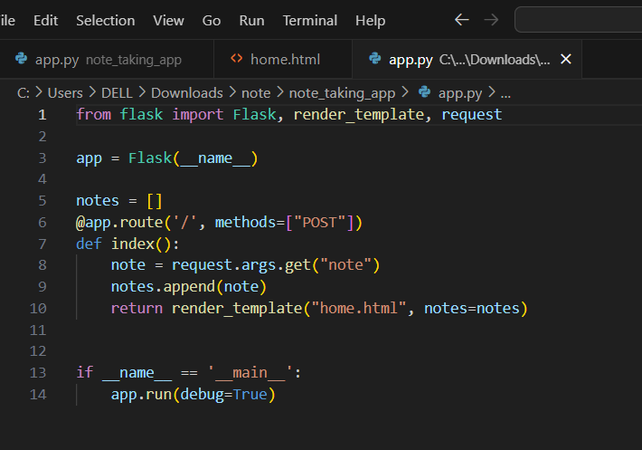
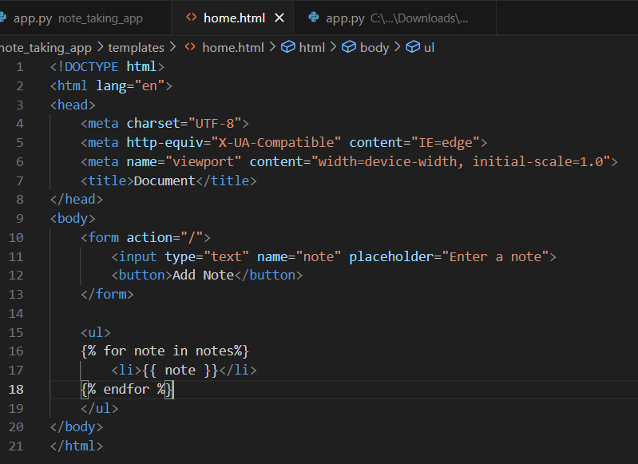
Initial Code:

Slide 5
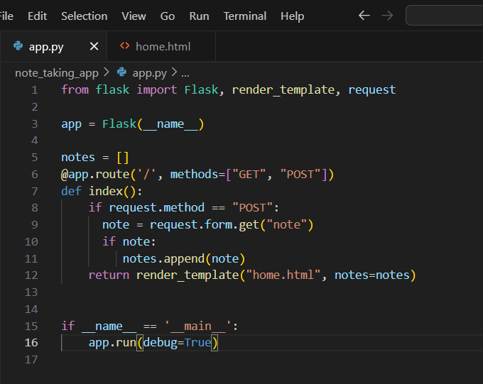
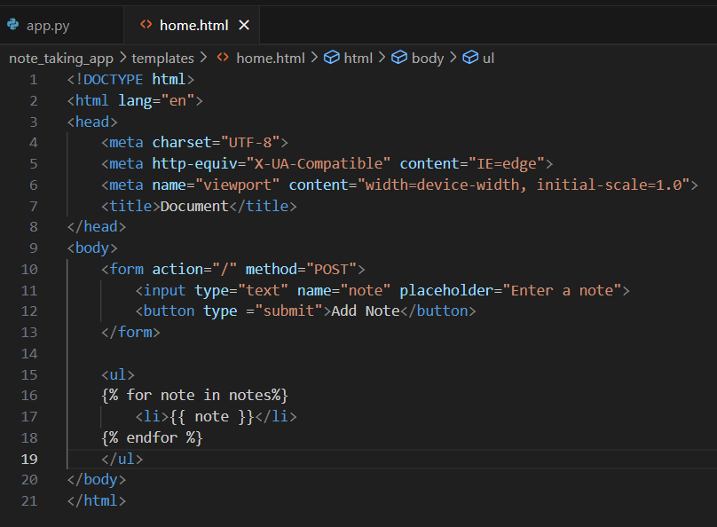
Resolved Code

Slide 6
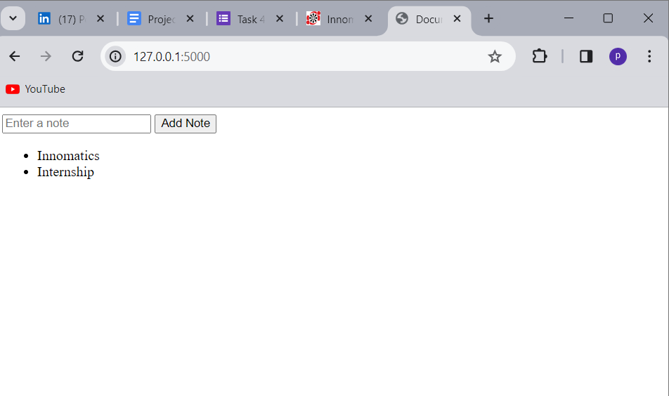
Verification:
Update the form action in the HTML template to
action="/" method="POST".
Restart the Flask application.
Add a note through the form on the homepage.
Conclusion:
The Route can now handle both GET and POST requests. The issue of notes not being displayed on the homepage of the Flask application after submission was resolved by updating the form action in the HTML template to ‘action=“/” method=“POST” ‘. After implementing and restarting notes are consistently displayed.

Slide 7

THANK YOU

